Slide 1
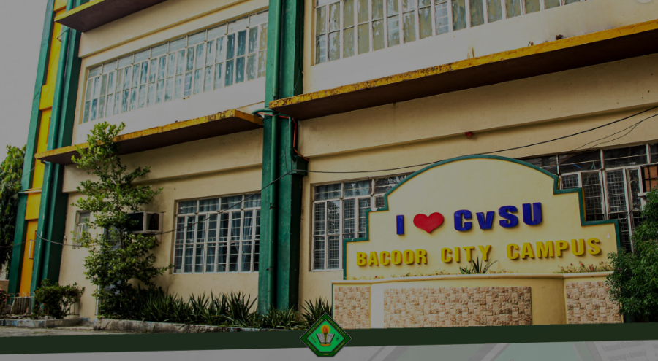
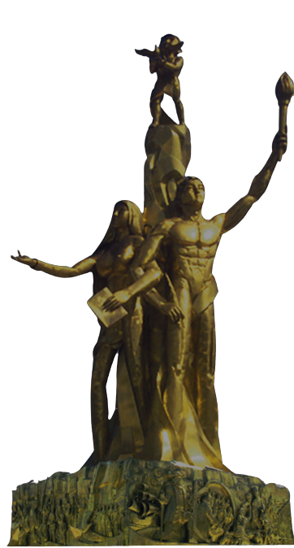
CAVITE STATE UNIVERSITY
BACOOR CAMPUS

